Slide 1
State Budget Update
More Big Challenges Ahead
October 2014

Slide 2
Washington’s economy is rebounding … but at a very slow pace

Slide 3
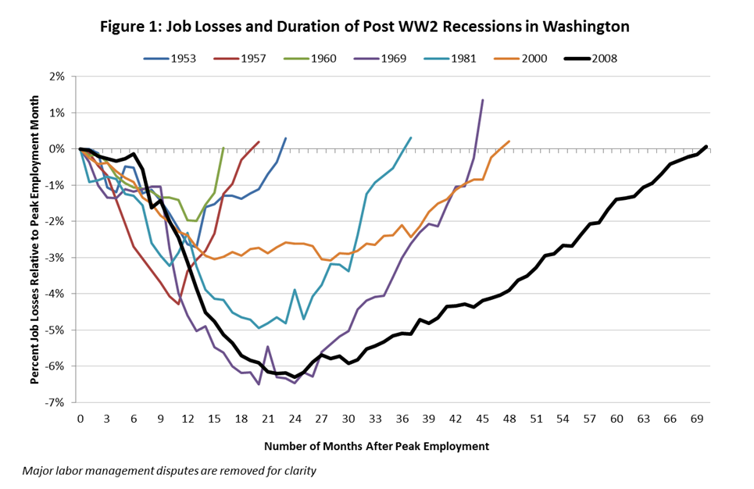
It took more than 5 years to recover all the jobs lost
during the Great Recession
Job losses and duration of Post WWII recessions in Washington

Slide 4
State revenue collections are also rebounding, but at a much slower pace than after previous recessions

Slide 5
State revenue remains well below historic growth trend
Total Near General Fund
assuming 4.5% growth
Total Near General Fund
Forecast

Slide 6
Looking ahead to the 2015–17 budget …
It could be more challenging than the 2013–15 budget

Slide 7
Why will the 2015–17 budget be so difficult?
We solved 2013–15 budget shortfall largely by relying on solutions not available again. For example, we:
Redirected $387 million in capital budget — including $277 million from the Public Works Assistance Account — to cover operating expenses.
Captured $351 million in savings by expanding Medicaid under the Affordable Care Act.
Raised $272 million by temporarily extending the hospital safety net assessment.
The budget includes new revenue — $159 million from the estate tax (Bracken) fix and $99 million in telecom reform savings.

Slide 8
The June 2013 forecasts also helped —
$230 million in additional revenue
and $229 million in caseload savings.
Even after all that, we once again needed to suspend teacher COLAs, and did not provide state employee pay raises
And still we fell short of our $1.5 billion target for meeting our basic education obligation

Slide 9
State revenue collections are expected to grow by more than $2.5 billion ...
What’s the problem?

Slide 10
Preliminary 2015–17 Operating Budget Outlook
Near General Fund (GF-State, Education Legacy Trust Account, Opportunity Pathways Account)
Projected Additional Revenue
$900 million
$2.6 billion
Projected Additional Spending Needs
Maintenance & Carry Forward Estimated $1.8 billion
Includes $647M to continue FY 2015 appropriation level.
Maintenance level estimate includes:
$175M low-income health care
$215M K-12 education
$150M mental health, DD, long-term care
Other obligations & policy options $600M includes:
lawsuits
early learning & higher education
state employee & higher education salaries
all other policy enhancements
$273M
pension costs
$200M
debt service
$302M
employee health care
$321M
I-732 COLA
$1.2 billion –$2 billion
McCleary
Office of Financial Management, as of August 2014

Slide 11
About 2/3 of the budget is protected by constitutional and federal requirements . . . So we must look to the other 1/3 for savings
Corrections 5%
Unprotected
Other 6.5%
Other Human Services 13%
Higher Education 9.2%
Mandatory
Medicaid 10.2%
Mandatory Services 8%
Debt Service/ Pensions 5.9%
K-12 Basic Education 42.3%
Protected
Notes:
As we look to where future cuts will be applied, we have to take into consideration which programs have strings attached that limit our ability to reduce spending.
This biennium, we estimate 70% of the state budget is “protected.” In some cases, we are able to achieve limited, selected cuts to protected programs, but must do so with an almost surgical precision, given the potential for legal challenges and need to maintain Maintenance of Effort -- or federal -- requirements.
This slide identifies parts of the budget that we consider “protected.” Protected items include:
Basic education – protected by the state Constitution
Debt service and pensions – protected by bond covenants and long-term funding obligations.
Mandatory federal entitlements “Medicaid and foster care” – If we take federal funding for these programs, we are required to follow federal laws and regulations that prescribe program design, benefit eligibility, and in some cases, rates paid.
Higher education – This year, higher education joined the “protected” category when the state took Recovery Act funds. State spending in this area must remain at a specified level while we use Recovery Act funds to avoid deeper cuts.
The weight of future reductions falls on the 30% of the budget that is not protected.

Slide 12
Some perspective on the
structural problem we face in Washington

Slide 13
Estimated cost to continue
phasing in HB 2776 (McCleary)
Projected cost of Initiative 732
(teacher COLAs)
Projected cost of enrollment
and other mandatory increases
13

Slide 14
Revenue collections are at historically low levels when compared to overall economy
General Fund-State revenue as percentage of Washington personal income
In 1990, GF-S revenue equaled about 7% of total personal income.
If the same were true today, we would have about $15 billion in additional revenue for current biennium.
Projected
Washington State Economic and Revenue Forecast Council, September 2013

Slide 15
In 1995, Washington ranked 11th in state and local tax collections … By 2011, we ranked 35th
State and Local Tax Collections Per $1,000 Personal Income
Fiscal Year 2011
U.S. Average = $108.31
Washington $98.95
Source: Bureau of Economic Analysis and Census Bureau U.S. Department of Commerce
Notes:
In 2011 (most recent data), Washington ranked 21st in per capita state and local tax collections ($4,213), down from 16th in 2008. And we are below the national average ($4335).
In 2011, Washington ranked 37 in state and local taxes "as a percent of gross state domestic product" -- down from 34th in 2008.
We rank 27th in per capita property tax collections ($1,286) and are below the national average ($1,436).
We rank 1st in per capita state and local sales tax collections.

